Slide 1
SUPERMARKET MANAGEMENT SYSTEM
MEMBERS:
ANSHUMAN TYAGI (9920103063) SAHIL KAPOOR (9920103065) ABHYUDAY DWIVEDI (9920103072) RAMANSH SAPRA (9920103088)

Slide 2





Slide 3
INTRODUCTION:
The project is based on the concept of managing the record of supermarket on regarding their customers and items. There are no login features in this simple application. This mini project contains limited features, but the essential one.
There are two portals in this program
ADMINISTRATOR
CUSTOMER:

Slide 4
Add product in the store by entering ID ,Name, price ,Quantity
Add
LINKED LIST
Display
Modify
Administrator
remove
Queue List
Shopping club
Customer
DE queue
Take trollie
Back to main
STACK
Exit
Buy something
ARRAY
Enter name queue
QUEUE
Program terminate

Slide 5
ADMINISTRATOR
In this we can add products, modify existing ones, delete products, display all the products, display customer list, dequeue customer.

Slide 6
CUSTOMER
In this we allow to get customers a trolli from whereon they can buy the products in any quantity based on the availability in the store by specifying the product id of the product from the list displayed added by the administrator and lastly a bill is also generated.

Slide 7
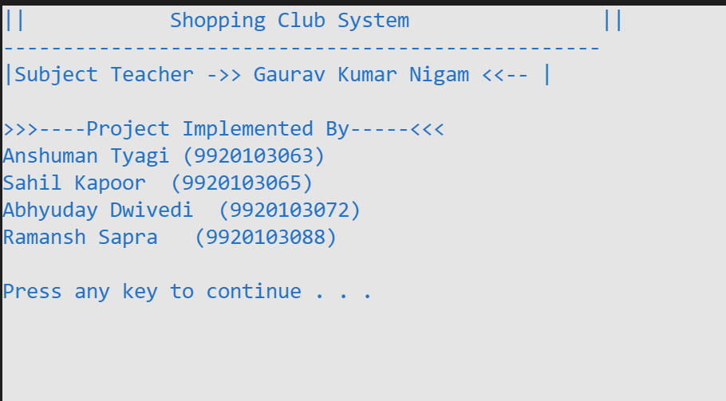
Main Screen

Slide 8
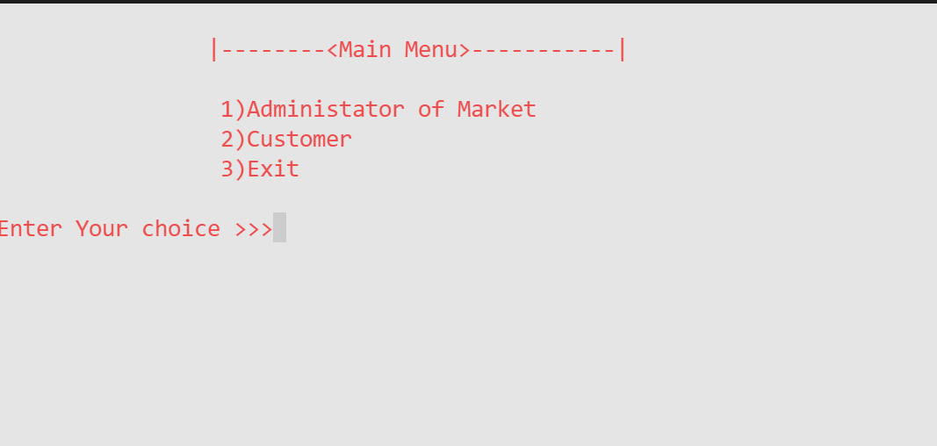
Main Menu

Slide 9
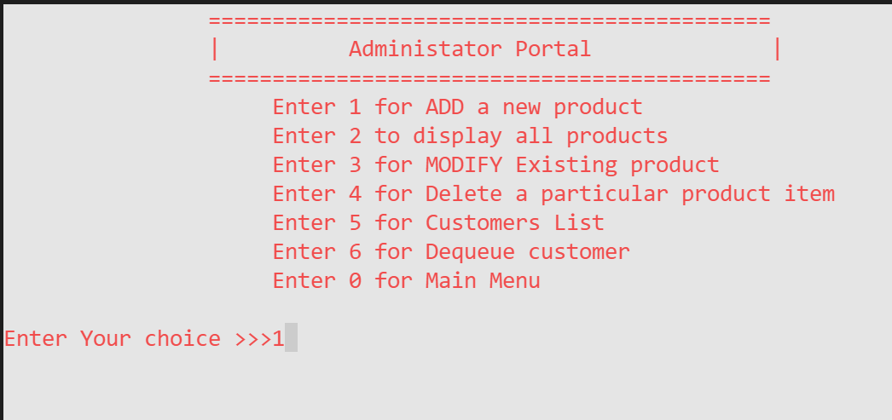
Administrator Portal

Slide 10
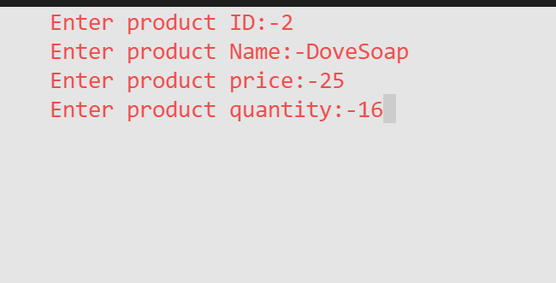
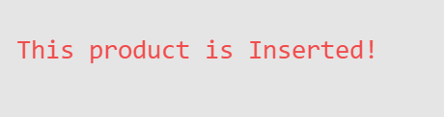
Adding a product

Slide 11
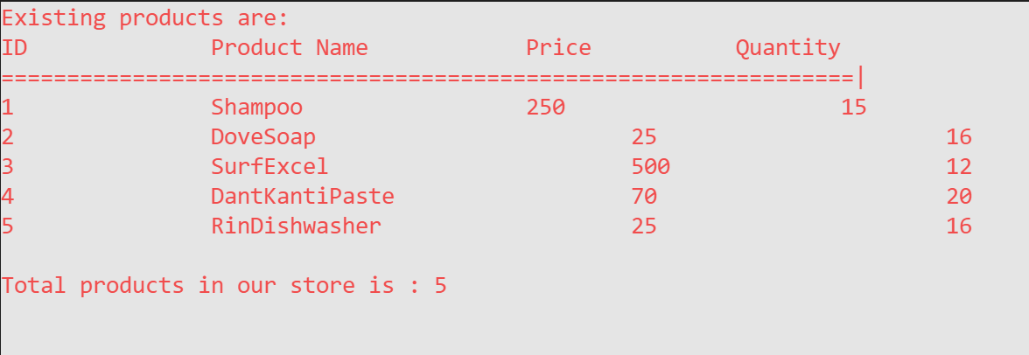
Display ALL PRODUCTS

Slide 12
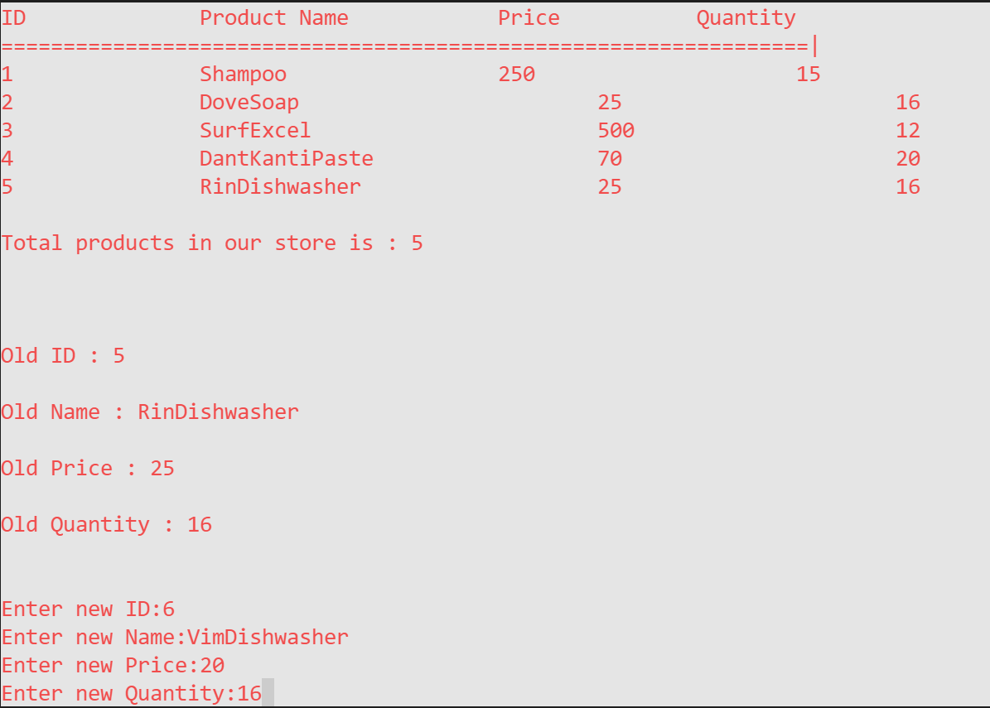
MODIFY EXISTING PRODUCT

Slide 13
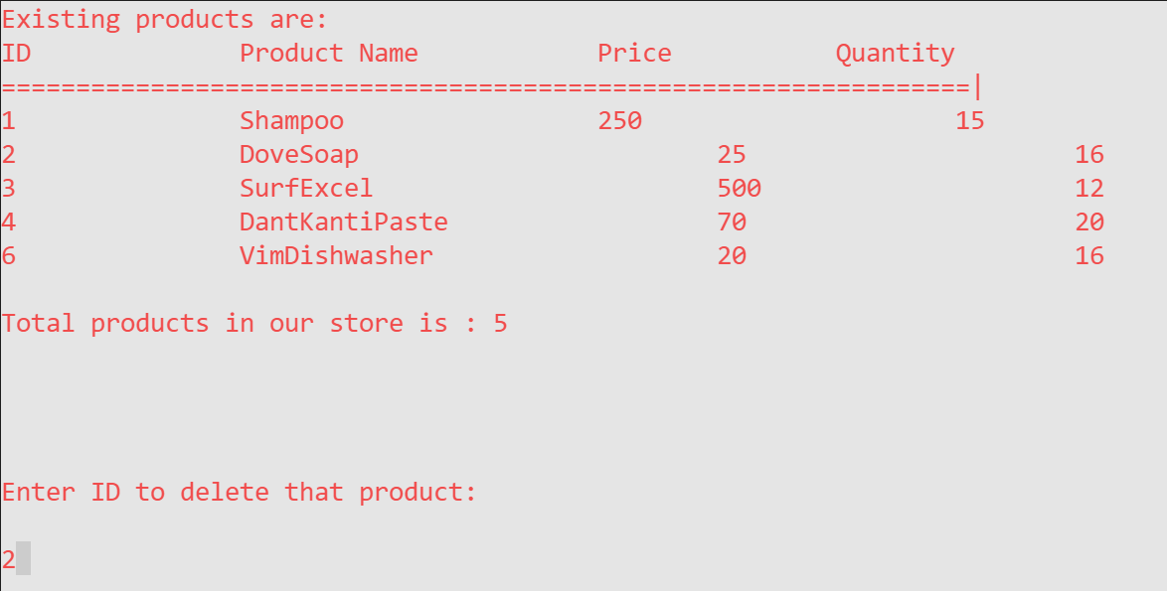
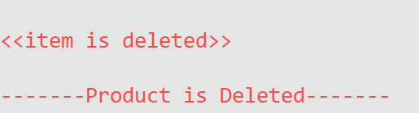
DELETE A PRODUCT

Slide 14
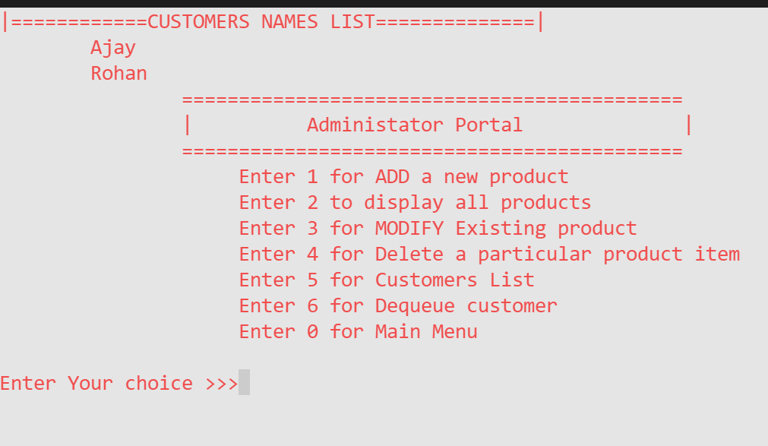
DISPLAY CUSTOMER NAME LIST

Slide 15
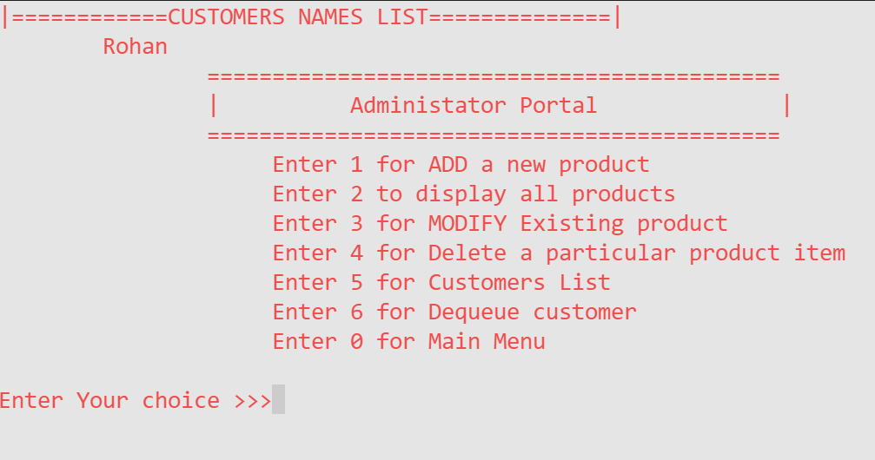
DEQUEUE A CUSTOMER

Slide 16
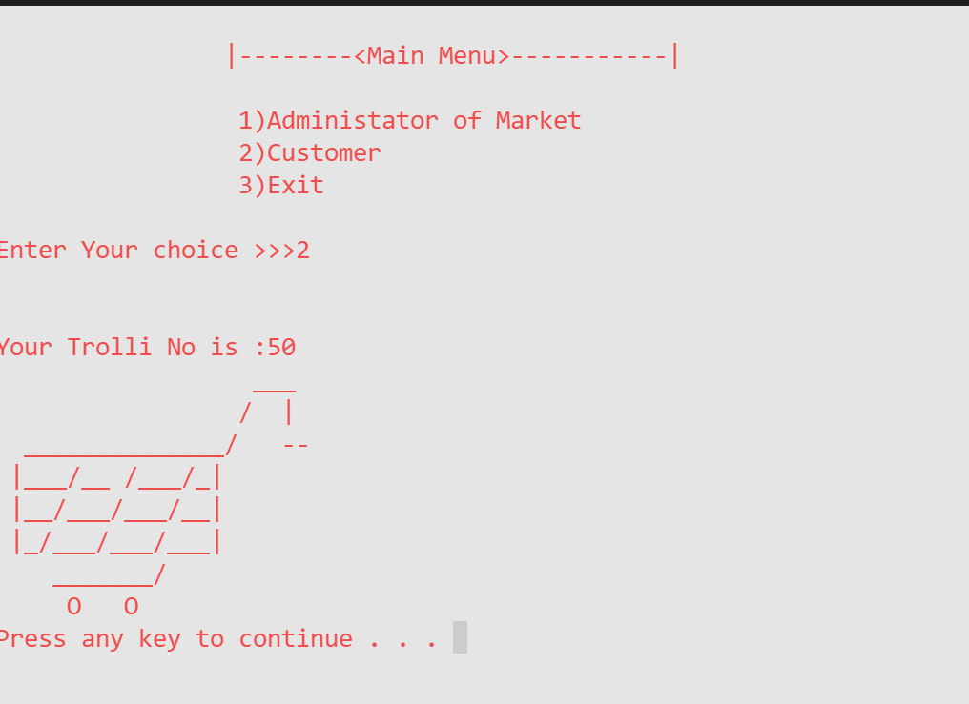
CUSTOMER PORTAL

Slide 17
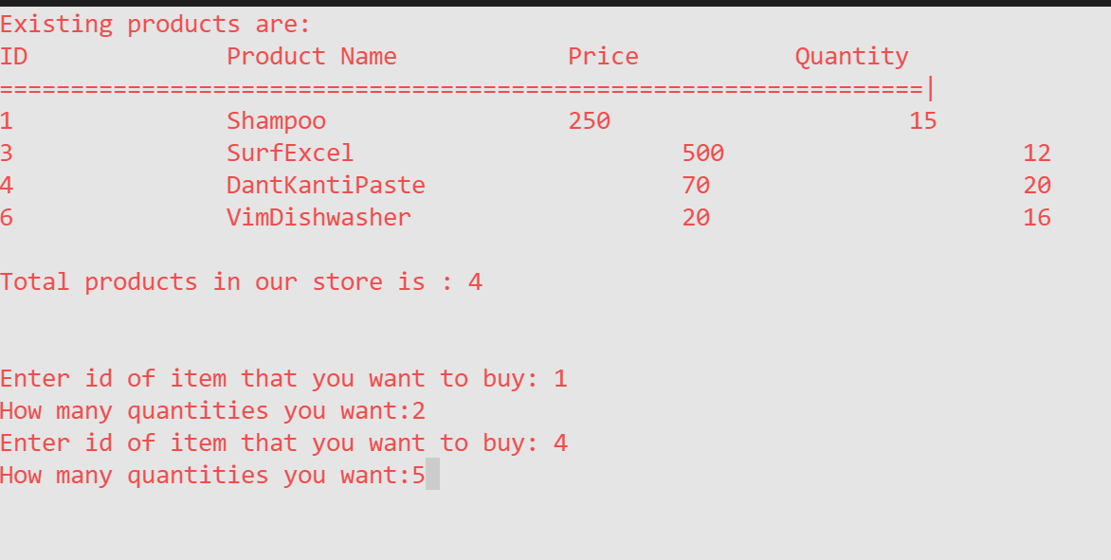
CUSTOMER PORTAL

Slide 18
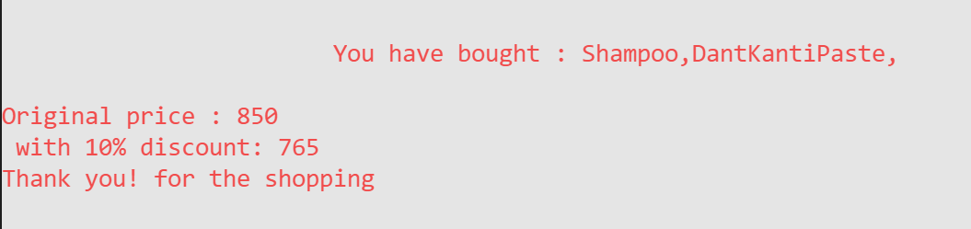
CUSTOMER PORTAL

Slide 19
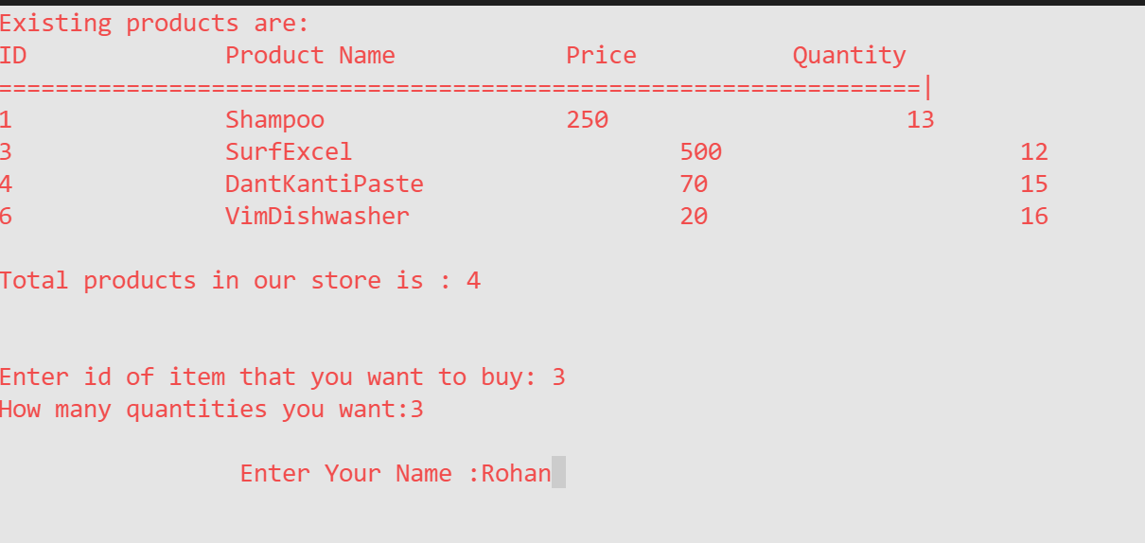
CUSTOMER PORTAL

Slide 20
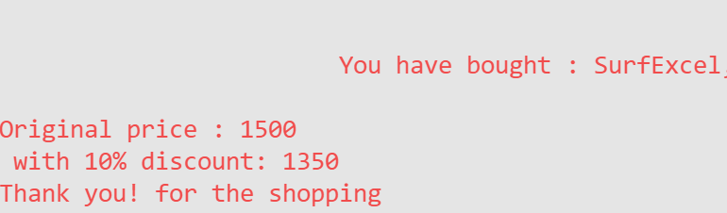
CUSTOMER PORTAL

Slide 21
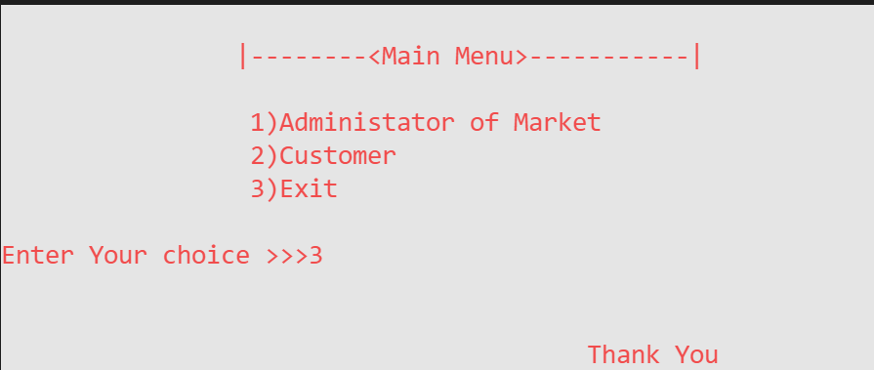
EXIT PORTAL

Slide 22


